Slide 1
GSRM Briefing re MS Motion
Skip Lumley
Chartwell Chief Methodologist
Thu Aug 16th 2006

Slide 2
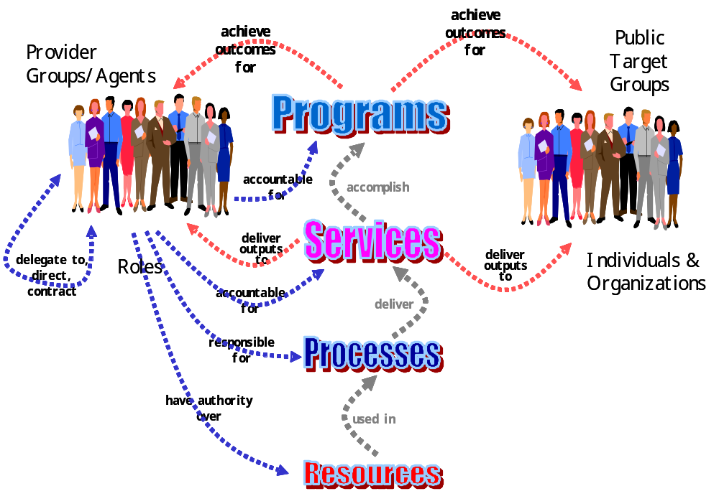
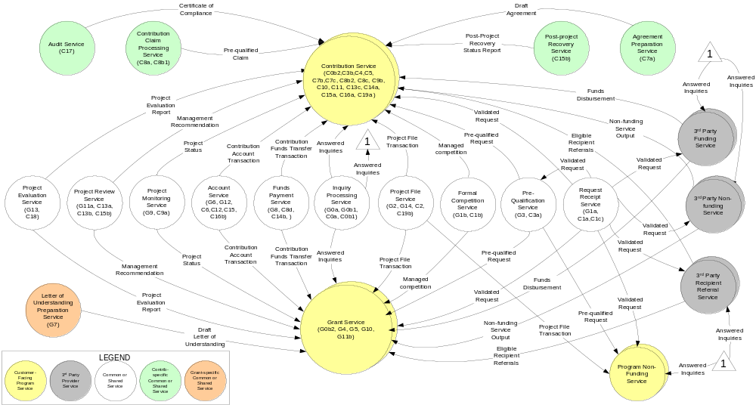
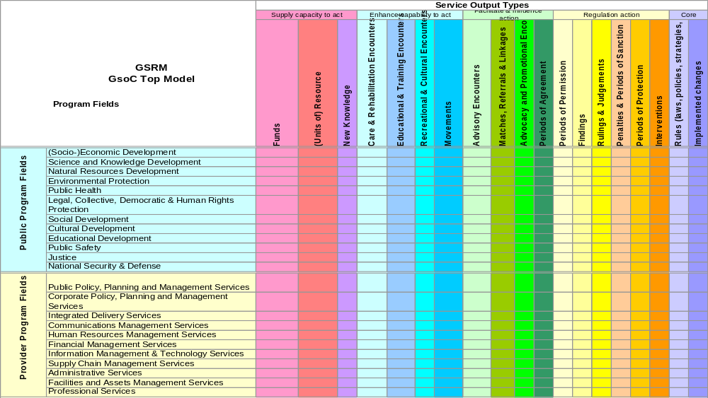
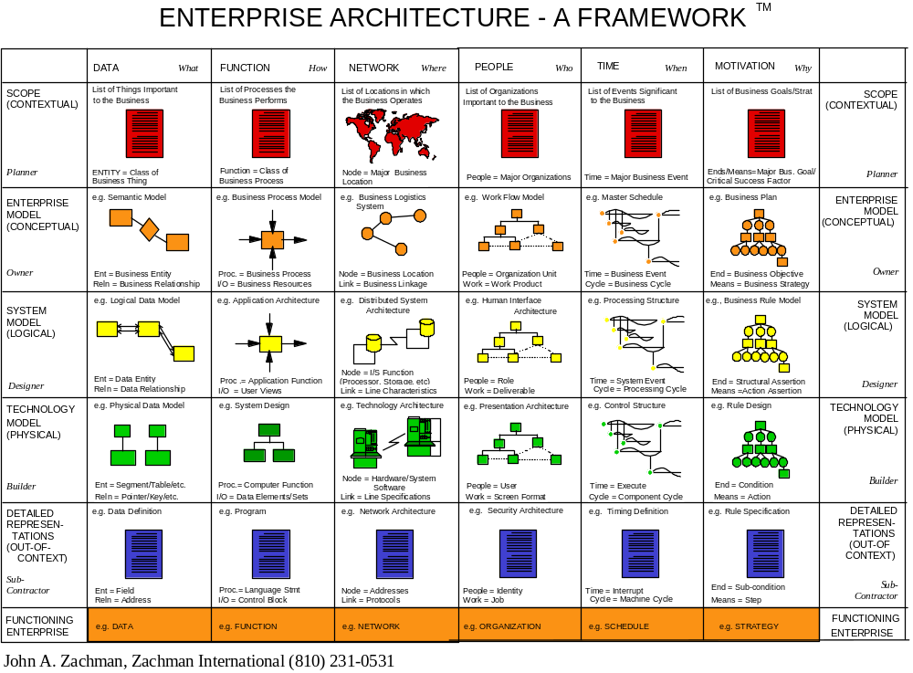
GSRM Components
BTEP (Business Transformation Enablement Program)
GSRM (Governments of Canada Strategic Reference Models)
Semantic & Structural Standards
PLM
Reference Patterns
Program
Logic
Model
PSAM
Program Service
Alignment Model
SIAM
Service Integrated
Accountability Model
Process & Workflow Models
(Activity Diagram, Swimlane Diagram, Use Case, etc.)
“Top Model”
Other EA Artifacts
Business Modeling Stack
Business Model Repositories
Notes:
Given a set of services, determine a precise set of functions for mapping into processes according to the GSRM Service Process Patterns.
This approach can also be used to generate a CBM map for the services.

Slide 3
GSRM sets semantic & structural concept standards

Slide 4
“Top Model” classifies all government activity
Third dimension = Target Groups
Notes:
This report shows the programs and services in the first column, mapped to service outputs and their outcomes in the columns. This provides similar information as the SIAM diagram.

Slide 5
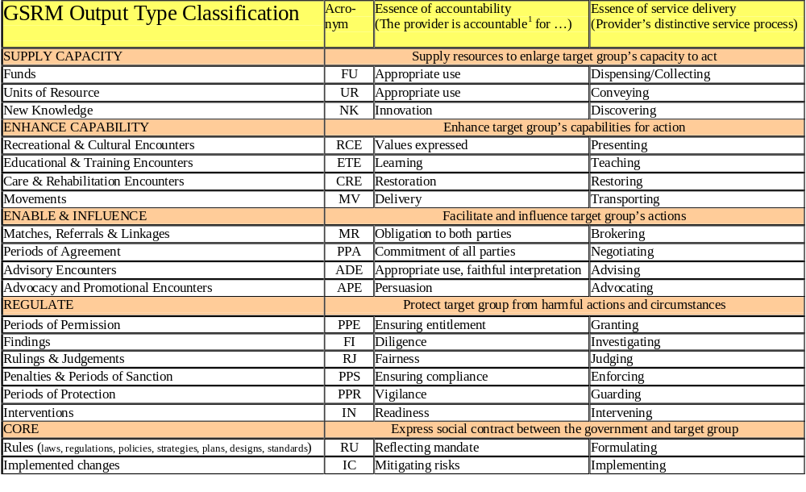
Service output types classify nature of activity

Slide 6
Program fields classify purpose of activity
Public Program Fields | Recognized Public Needs
(Socio-) Economic Development | Need to organize, work, trade and prosper
 | Need for protection from economic crimes
Science and Knowledge Development | Need for new knowledge
Natural Resources Development | Need to use/consume natural resources
 | Need to sustain/renew natural resources
Environmental Protection | Need to enjoy and rely on the natural environment
Public Health | Need for protection from illness and disease
Legal, Collective, Democratic & Human Rights Protection | Need for recognition and protection of legal, collective, human, and democratic rights and freedoms
Social Development | Need to overcome disadvantages
 | Need to help others and share prosperity and community
Cultural Development | Need for preservation of identity, history, tradition, values
Educational Development | Need to develop human capabilities
Public Safety | Need for protection from natural and built hazards
 | Needs for protection from violent crime
Justice | Need for fair and just treatment
 | Need to sanction (punish) law-breakers
National Security & Defence | Need for protection from insurrection, terrorism, international threats and defence of freedom

Slide 7
Program fields classify needs and distinguish the public from providers
Provider Program Fields | Recognized Provider Needs
Public Policy, Planning and Management Services | Need to address public needs and accomplish public goals
Corporate Policy, Planning and Management Services | Need to shape the enterprise to accomplish public goals
Integrated Delivery Services | Need to integrate service delivery from different program fields
Communications Management Services | Need to communicate with the public and with providers including the government
Human Resources Management Services | Need to deploy and steward the government's human resources
Financial Management Services | Need to deploy and steward the government's financial resources
Information Management & Technology Services | Need to deploy and steward the government's information
Supply Chain Management Services | Need to ensure supply and conserve the government's resource expenditures
Administrative Services | Need to deploy and use the government's resources, facilities and assets
Facilities and Assets Management Services | Need to maintain and steward the facilities and assets entrusted to the government's care
Professional Services | Need to comply with laws, regulations and best practices as an enterprise

Slide 8
Patterns expressed in terms of programs and services approach closer to invariance

Slide 9
ICT artifacts are derived from business model artifacts
GSRM Business
Architecture
Primitives
Conceptual Models
Information
Architecture
Technology
Architecture
Applications
Architecture

Slide 10
GSRM Business Modeling Stack Ensures Strategic Alignment
Strategy & Policy Design
PLM
PLM aligns direct, intermediate and strategic outcomes with
program and service design to ensure vertical accountability.
Program
Logic
Model
PSAM
PSAM aligns program and service designs with target groups and
recognized needs to ensure program effectiveness
Program Service
Alignment Model
SIAM
SIAM aligns service and process design within and between
programs to ensure horizontal accountability, service quality,
program efficiency
Service Integrated
Accountability Model
Process and workflow models decompose
service and process designs, ensuring compliance with
strategic and policy design requirements
Process & Workflow Models
(Activity Diagram, Swimlane Diagram, Use Case, etc.)
Tactical & Operational Business Design
(c) Chartwell 2005

Slide 11
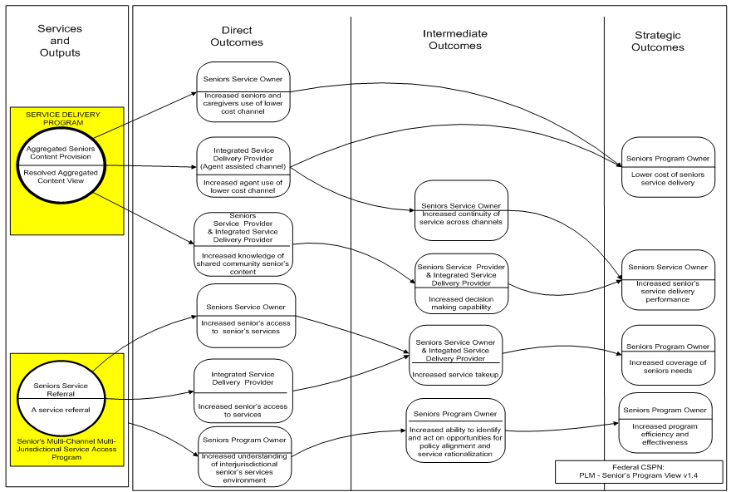
PLM Example

Slide 12
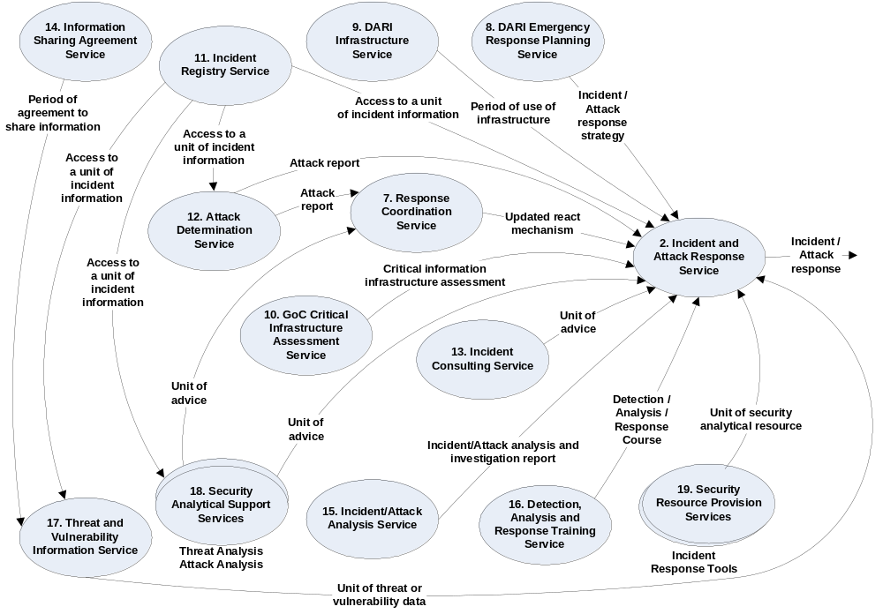
DARI Service Accountability in Context
SIAM Example

Slide 13
The realms of a public sector enterprise can be modeled independently
Programs
Needs
Policy/Strategy
Realm
Business
Realm
Clients
Services
Resources
Work
Realm
Processes
Organization
Workflow
Roles
Locations
Resource
Realms
Applications
Domains
Interfaces
Nodes
Databases
Infrastructure
Components

Slide 14
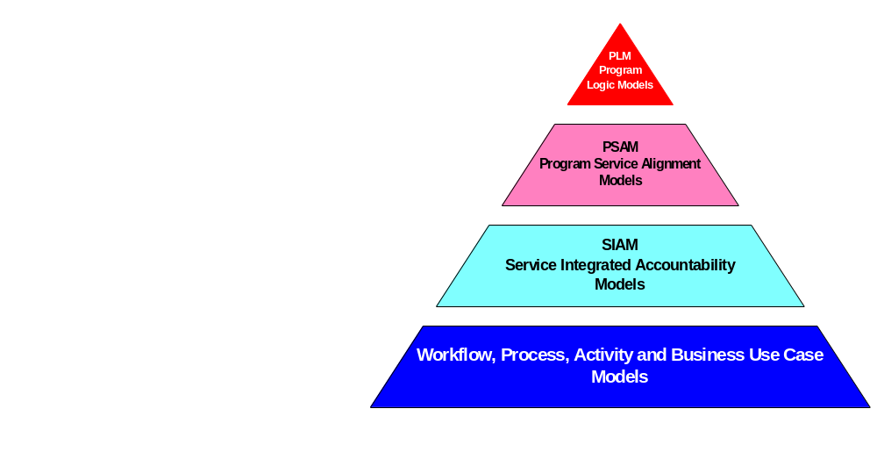
Translating policy and strategy into work
GSRM Service Process Patterns

Slide 15
What Problem Are We Trying to Solve?
Processes Decompose!
Process
Activity
Activity
Task
Task
Task
Task
Process start and end points can be logically defined, but process decomposition cannot
No way to guarantee two analysts will identify the same processes in the workstream
This is one of the two biggest business design obstacles leading to the creation of “silos” (the other being organizational/political).
There are techniques and reference models to address this in certain circumstances, but the GSRM provides a normative means.

Slide 16
GSRM Service Process Patterns
GSRM Service Process Patterns are normative patterns, not best practice patterns
Normative patterns ensure consistency in defining business processes and performance measures

Slide 17
All GSRM Services are Peers
Program
Sub-
Program
Sub-
Program
Target
Group
Service
Service
Service
Service
Service
Service
Programs sub- and super-set.
Services are “flat”.
There is no such thing as a “super-service” or “sub-service”

Slide 18
GSRM Service Processes are Reusable Building Blocks
Services: work defined in terms of accountability and re-/multi-use
Service 1
Service 2
Service 3
Service 4
Service 5
Service 6
Processes: work defined in terms of inputs, outputs and flow
Service 1
Service 2
Service 3
Service 4
Service 5
Service 6

Slide 19
“Business” Processes are defined in terms of GSRM Service Processes
Service 1
Service 2
Service 3
Service 4
Service 5
Service 6
Business Process is the aggregate of each Service’s Value Chain Service Processes
Service 1
Service 2
Service 3
Service 4
Service 5
Service 6

Slide 20
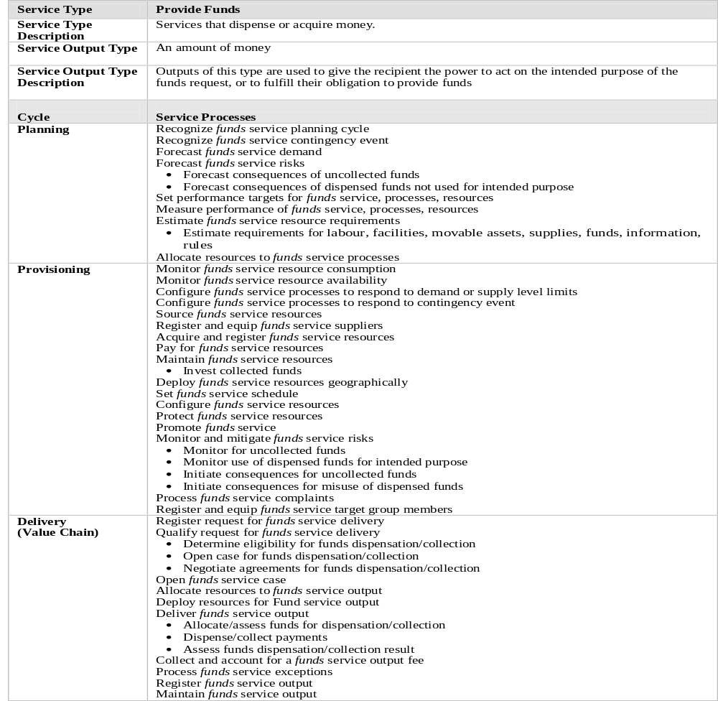
Example: “Provide Funds” Level 2 Service Process Pattern

Slide 21
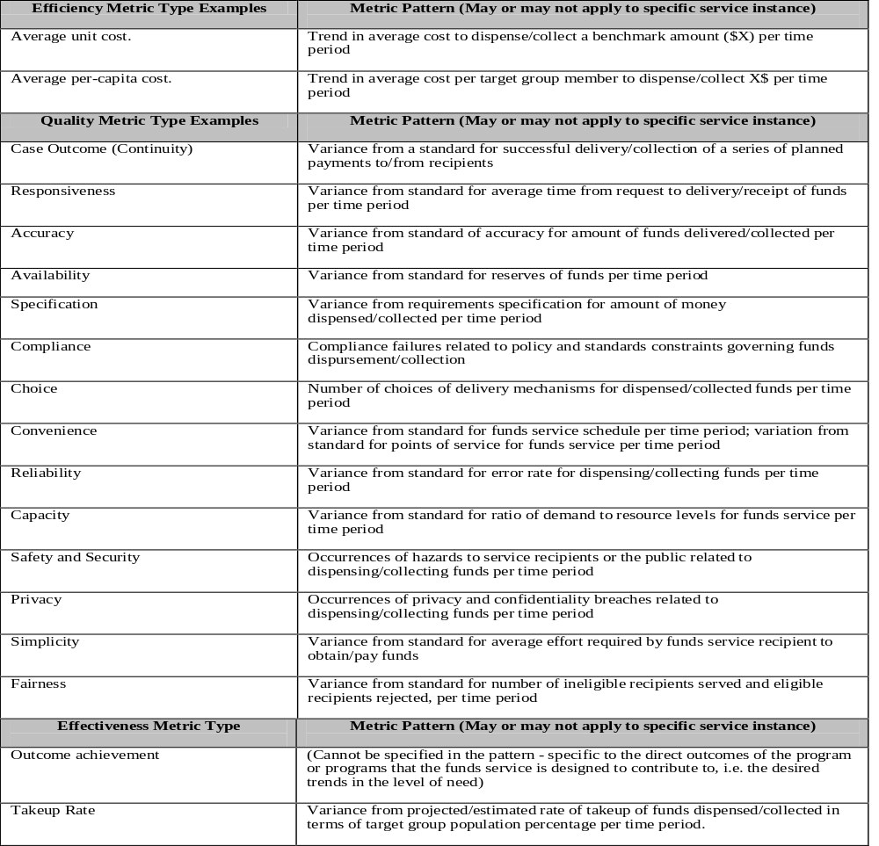
Example: “Provide Funds” Level 2 Service Metrics Pattern

Slide 22
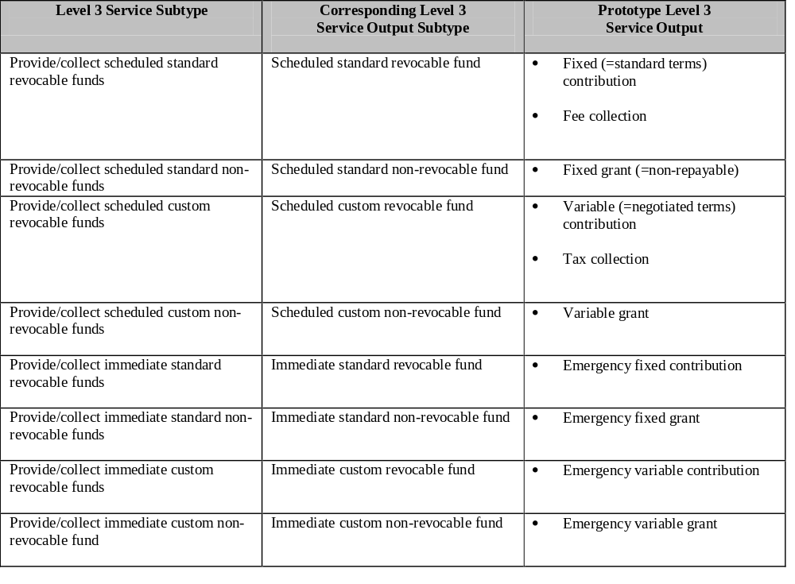
Example: “Provide Funds” Level 3 Service Subtypes

Slide 23
GSRM and MS Motion

Slide 24





GSRM Services and Processes mobilize Motion Capabilities and Functions
Org
Org
Org
Org
Org
Target
Groups
Inputs
Service/Process
Outputs
Direct
Outcomes
Intermediate
Outcomes
Inputs
Service/Process
Outputs
Direct
Outcomes
Strategic
Outcomes
Intermediate
Outcomes
Inputs
Service/Process
Outputs
Direct
Outcomes
Strategic
Outcomes
Intermediate
Outcomes
Inputs
Service/Process
Outputs
Direct
Outcomes
Strategic
Outcomes
Intermediate
Outcomes
Inputs
Service/Process
Outputs
Direct
Outcomes
Specialized
Resources
Specialized
Resources
Specialized
Resources
Specialized
Resources
Specialized
Resources
© Chartwell 2005

Slide 25
Two orthogonal views to represent the organization’s work
Functional/Capability Model
  Definition: specialization of resources including labour
  Technique: KBR Lifecycle analysis
Pros
  Organizational roles & responsibilities
  Systems requirements
  Familiarity
Cons
  “Functional silos”
  Accountabilities (outputs, outcomes)
  Performance measures
Service/Process Model
  Definition: final valued outputs
  Technique: PLM/PSAM/SIAM
Pros (in relation to functional model)
  Strategic alignment
  Organizational accountabilities (outcomes, outputs)
  Performance measures
  Can account for transition work
Cons
  Less familiar
  “Program silos”
  Different approach needed for systems (EA)

Slide 26
Challenge of scale & complexity in the public sector
 | Typical no. of programs | Typical no. of services
Municipal & Regional | S: 20-30 L: 40-50 | S: 100-150 L: 200-350
Provincial (30-60 agencies) | 300-500 est. (388+ in Ont) | 1000-2000 est. (1700+ in Ont)
Federal (160 agencies) | 1500 est. | 5000 est.

